Slide 1
simple inventory tracker
by Phuong Vo

Slide 2
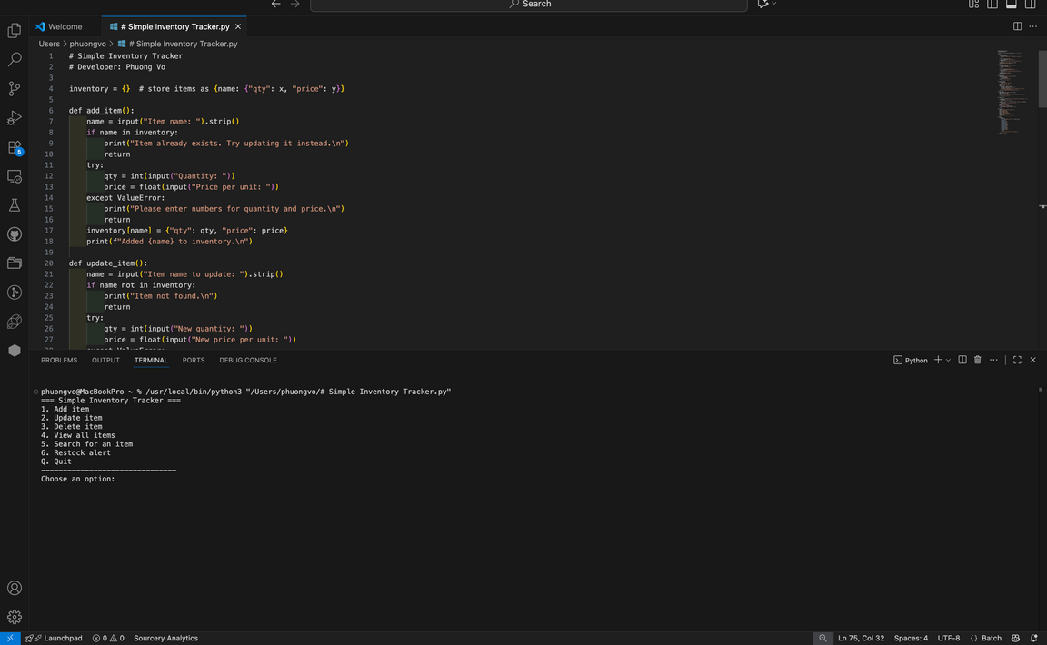
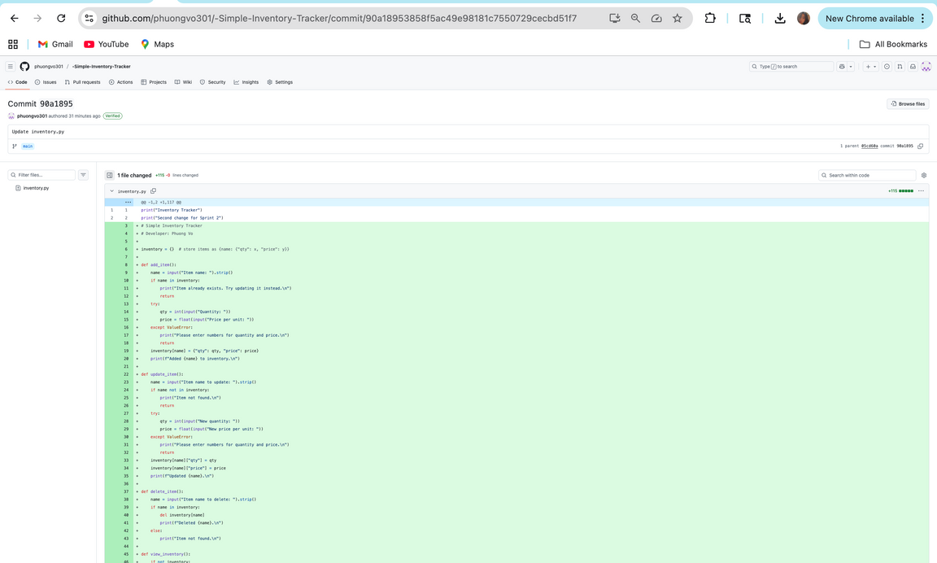
Simple Inventory Tracker
  Developer: Phuong Vo
  Tagline: Track your supplies faster and easier
  Feature: add, update, search, and export inventory

